Slide 1



RECRUITMENT AND SELECTION PLAN FOR PROJECT ASSOCIATE
XYZ RECRUITMENT, INC. FOR STATE UNIVERSITY
Presented by : Frank Ellsworth

Slide 2


OVERVIEW OF RECRUITMENT PLAN
  Define recruitment strategy aligned with goals.
  Use grid to assess candidate qualifications.
  Ensure a diverse applicant pool.
  Apply consistent evaluation methods throughout.
  Communicate with HR for feedback regularly.
  Collaborate with hiring managers for final decision.
Notes:
The recruitment plan for the Project Associate position is tailored to align closely with the overall strategic goals of State University. This process centers on using the recruitment grid, a key tool in objectively and fairly evaluating candidates. With the grid, we ensure that every candidate is evaluated based on clear, predefined qualifications that help eliminate bias in the evaluation process. Ensuring diversity and inclusion means having a wide range of candidates applying for this role (Al-Shatti & Ohana, 2021). Besides that, the assessment methods for these candidates must not be changed; they should remain consistent throughout, and each candidate should be treated on an even basis in the process. A critical point: Collaboration between the human resources representatives, the hiring manager, and the recruiter will be extremely important so we are on the same page regarding the process and candidate profile. Regular feedback and communication will be shared throughout the recruitment process to keep all stakeholders informed and to facilitate timely decision-making.

Slide 3

KEY QUALIFICATIONS FOR PROJECT ASSOCIATE
  Bachelor’s degree required for the role.
  Strong project management experience essential.
  Proven ability to meet deadlines efficiently.
  Strong communication and organizational skills.
  Experience working with multiple stakeholders.
  Leadership potential and team management skills.
Notes:
Key qualifications for the Project Associate position are planned so that the candidate should possess the knowledge, skills, and experience required for the post. A Bachelor's degree is necessary for a basic academic background to handle projects efficiently. In addition to academic credentials, strong project management experience is necessary to ascertain that the candidate can manage different tasks, timelines, and resources associated with projects within a university setup (Frampton et al., 2020). The position, therefore, requires effective communication and organizational skills, as the Project Associate will be involved in communicating with different stakeholders and working across departments. The candidate should also be proven to deliver on deadlines and work well under pressure. Leadership potential is necessary to guide project teams and make decisions when necessary. Finally, experience working with multiple stakeholders, such as external vendors or faculty members, is a key ingredient in the performance of the job.

Slide 4
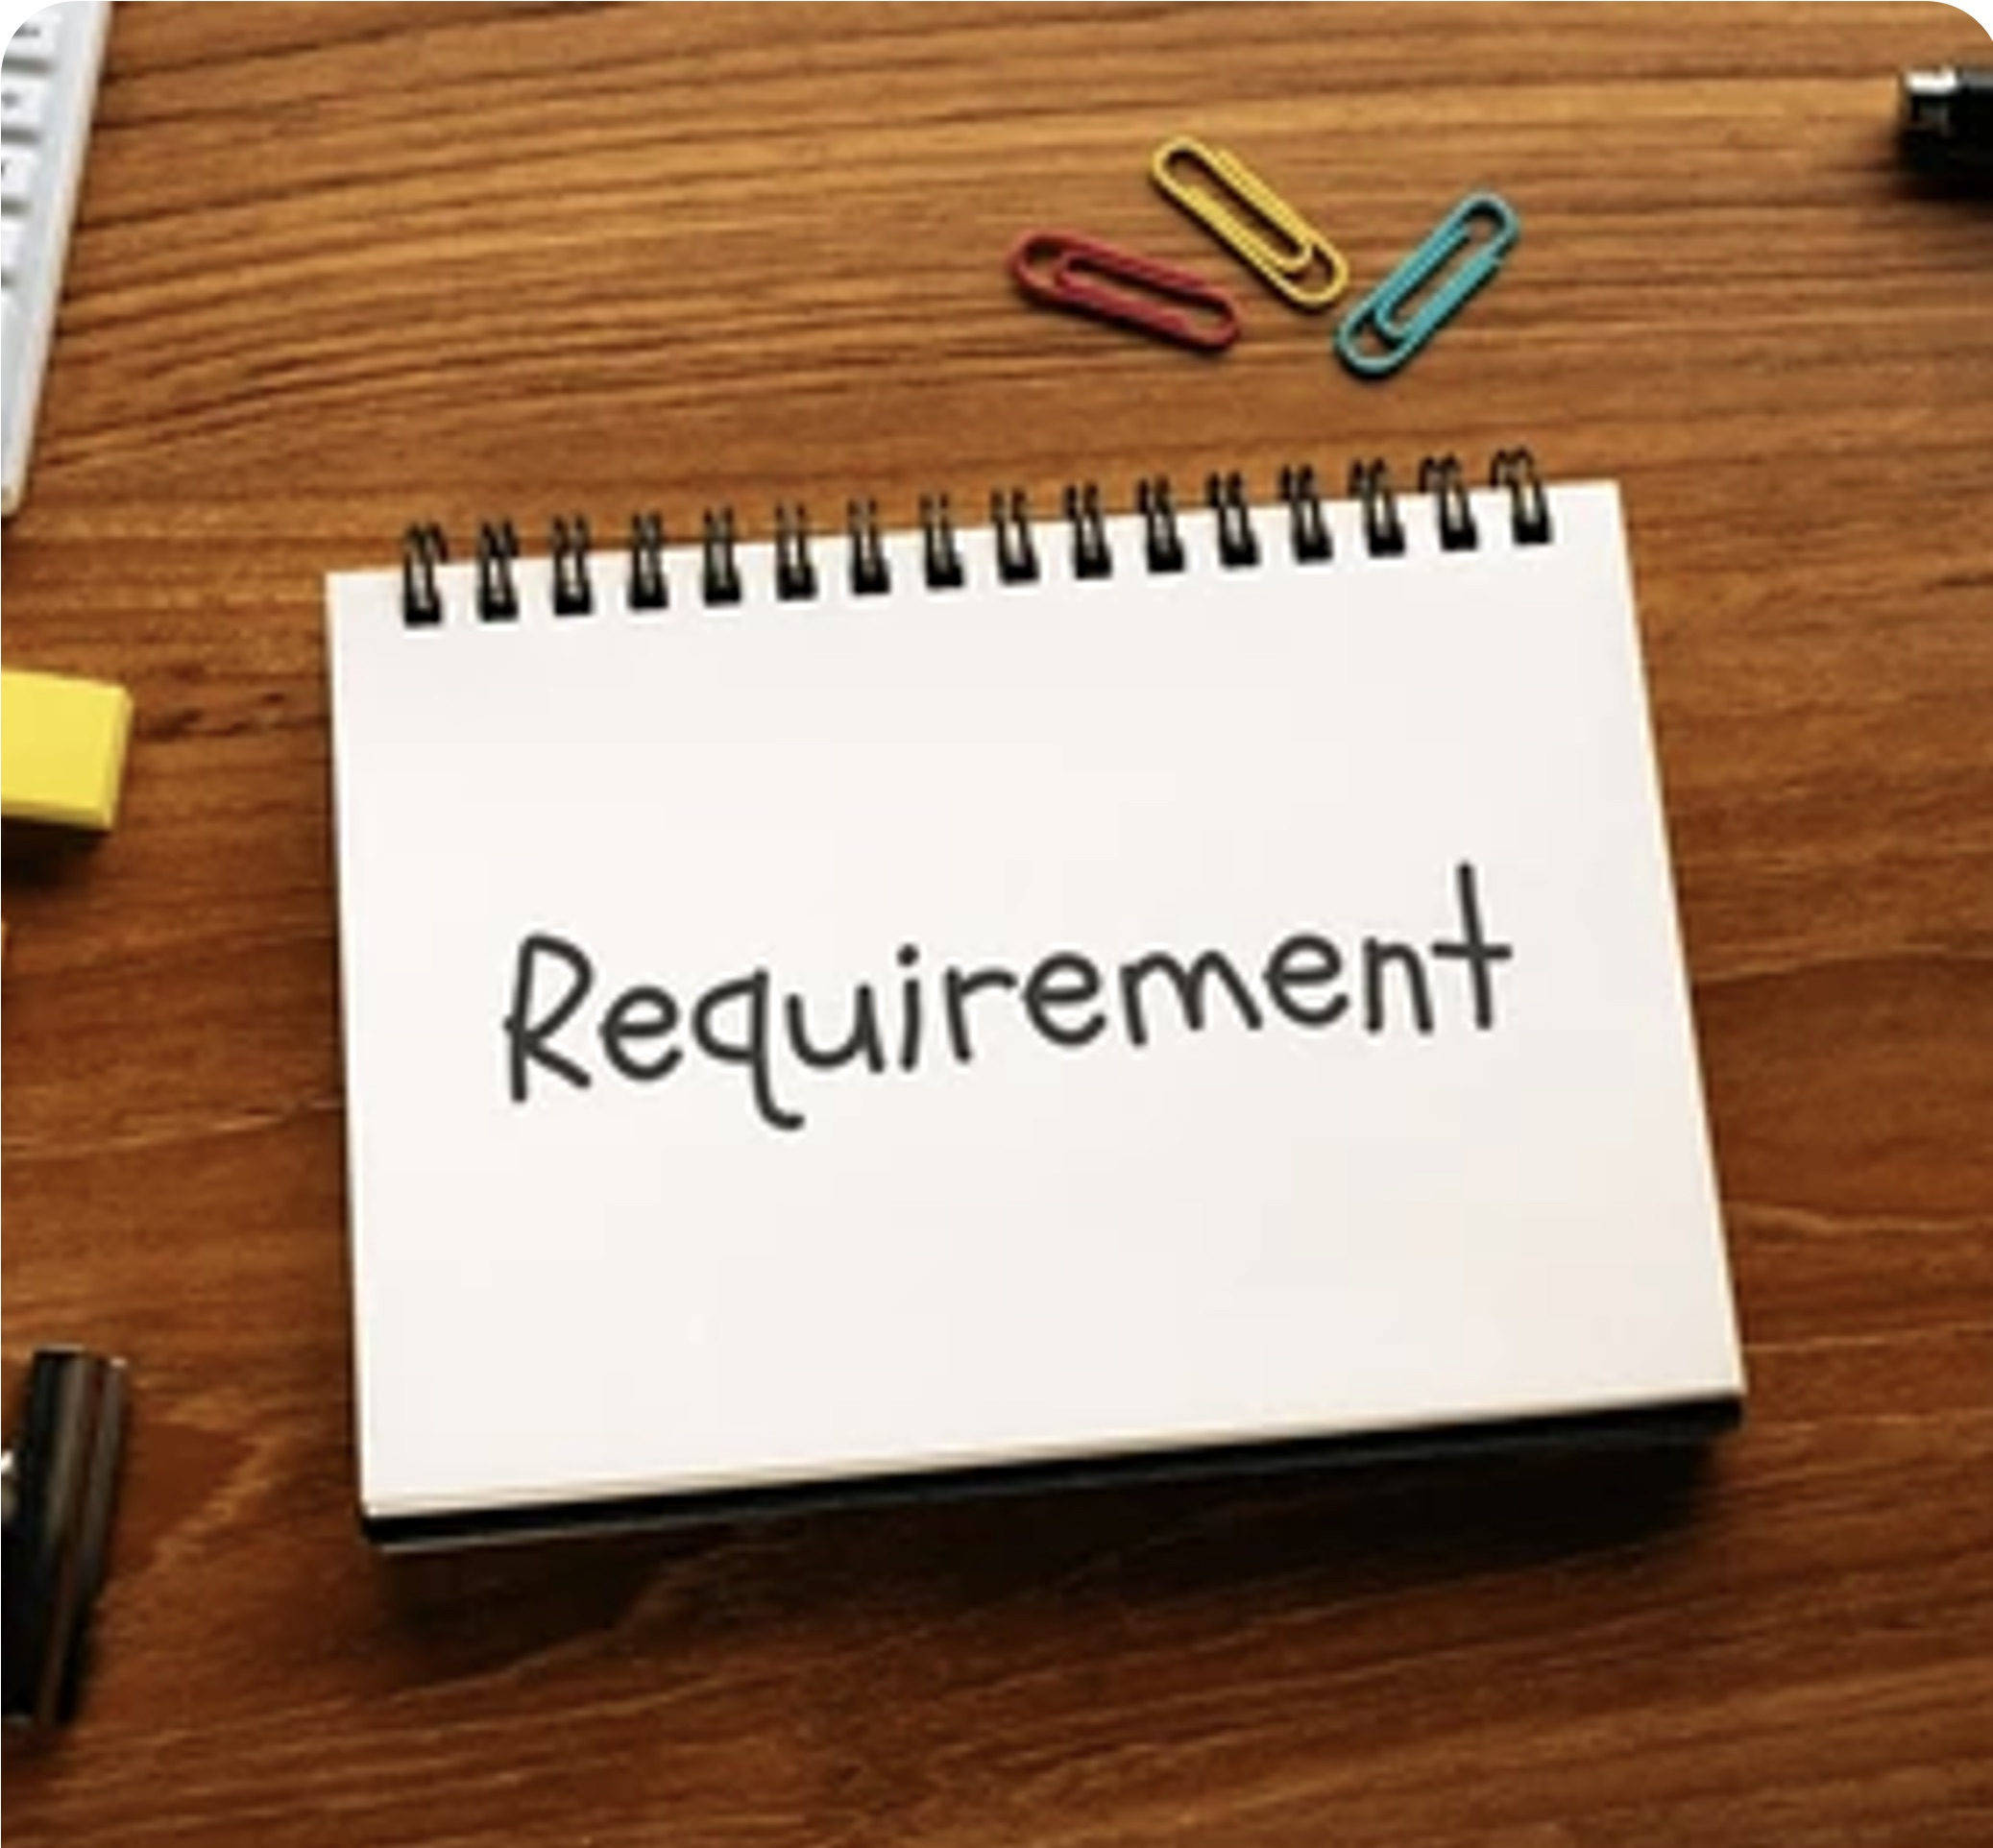
ESSENTIAL AND DESIRABLE REQUIREMENTS BREAKDOWN
  Essential: Degree, project management, communication, leadership.
  Desirable: PMP certification, experience with project tools.
  Essential: Organizational skills, vendor management.
  Desirable: Experience in academic environments, familiarity with Jira.
Notes:
In the recruitment process, some requirements are distinguished as essential or desirable. For example, meeting essential requirements can be done by having a Bachelor's degree, project management experience, and strong communication skills. Thus, this constitutes the requirements that every potential worker needs to meet to qualify for an entity. The desirable requirements are unnecessary; they tell that a candidate is far and away a better candidate by enhancing a fit in the roles the application has targeted. Examples of these certifications that are highly desirable yet need to be more indispensable are PMPs and project management instruments (Maurer, 2023). Therefore, it would also be relevant to desirable candidate traits if the experience was found academically since this usually engendered a greater sense of peculiarities common throughout the university environment or educational institution. Using a recruitment grid helps draw a clear demarcation between the two categories and makes scoring objective.

Slide 5

INTERVIEW PROCESS AND EVALUATION CRITERIA
  Structured interviews for consistency and objectivity.
  Assess technical and soft skills during interviews.
  Evaluate leadership, communication, and problem-solving.
  Use scoring system for fair evaluation.
  Score interview performance on a 1-10 scale.
  Final decision based on total candidate score.
Notes:
One of the main points related to this recruitment strategy is an interview. It is useful in such a way that the entire process allows us to assess the following important features of the person: technical and soft skills. The candidates should be asked questions based on what is called a structured scope of an interview. Standards ensure fairness in bringing subjects under one question to all respondents (Al-Shatti & Ohana, 2021). In the interview, we would still need to assess technical competencies related to project management; however, other valuable competencies in soft-skill areas, such as communication, problem-solving, and teamwork, will also feature very strongly. The extent to which management potential will also need assessment as the Project Associate is supposed to manage teams and coordinate with stakeholders. In the interview and selection procedure, each candidate's performance will be scored on the recruitment grid to ensure fairness and objectivity. Their interview performance and other stated criteria will determine the best candidate.

Slide 6

SCORING SYSTEM AND POINT ALLOCATION
  Essential requirements rated 1-5.
  Desirable requirements rated Yes (1) or No (0).
  Interview performance rated 1-10.
  Total score based on all evaluations.
  Higher scores indicate stronger candidate fit.
  Objective and data-driven approach.
Notes:
This evaluation methodology ensures that candidates are selected by merit, qualifications, experience, and suitability as established at the interview. The requirements that are considered essential will be evaluated on a rating scale from 1 to 5, where 1 is the least applicable to the requirement, and 5 is an excellent fit. In this way, the rating system will enable us to distinguish between different levels of competence. All desirable requirements will be scored on a Yes/No (1/0) basis, where Yes=1 and No=0. Interview scoring will be based on a scale of 1-10, where 10 represents an outstanding performance and 1 reflects significant areas for improvement. This means the total of the essential, desirable, and interview scores for each candidate to indicate the most qualified candidates. The grid will be used to ensure the selection is consistent and transparent.

Slide 7

ESSENTIAL REQUIREMENTS DETAILED EXPLANATION
  Degree in relevant field (1-5 scale).
  Experience in project management (1-5 scale).
  Strong communication skills (1-5 scale).
  Leadership potential (1-5 scale).
  Organizational and time management (1-5 scale).
  Vendor management (1-5 scale).
Notes:
The requirements of the Project Associate position are fundamental in making sure that the candidate will be able to perform the key responsibilities: a degree in a relevant field is crucial because it assures that the candidate has acquired the basic academic knowledge relevant to the management of the project; similarly, experience in project management is an essential requirement given the nature of projects the Project Associate will be working on, most of which are complex and may require stringent completion. Communication skills are key in this role, as the Project Associate will be exposed to various teams, stakeholders, and vendors with whom he or she must communicate. Leadership potentiality is also needed in this role because a person needs to coordinate teams, make decisions, and keep others motivated toward project success. Managing multiple tasks with effective prioritization will be important; hence, organizational skills are also required. Last is vendor management, which requires the candidate to deliver on project objectives through liaising with external vendors.

Slide 8

DESIRABLE REQUIREMENTS DETAILED EXPLANATION
  PMP or related certification (1 for Yes).
  Experience with project management tools (1 for Yes).
  Experience in university or academic setting (1 for Yes).
  Knowledge of project management software (1 for Yes).
  Ability to manage external vendors (1 for Yes).
  Familiarity with cross-functional team collaboration (1 for Yes).
Notes:
While the essential requirements are necessary for one to be considered, desirable requirements are not necessary, yet they add to a candidate's fitness for the job. For example, the PMP certification is considered a desirable requirement because such a certification indicates that one has acquired advanced knowledge of project management and industry-standard best practices (Al-Shatti & Ohana, 2021). Experience with project management tools, such as Jira, would allow the candidate to hit the ground running since these tools are commonly used for managing projects and tracking progress. Experience within an academic environment is also desirable since it ensures the candidate understands the challenges and demands of working in a university setting. Vendor coordination experience is another desirable trait, as the Project Associate must work with external vendors. Collaborating across teams and departments is also valuable, as the role requires working with various stakeholders to ensure project success.

Slide 9
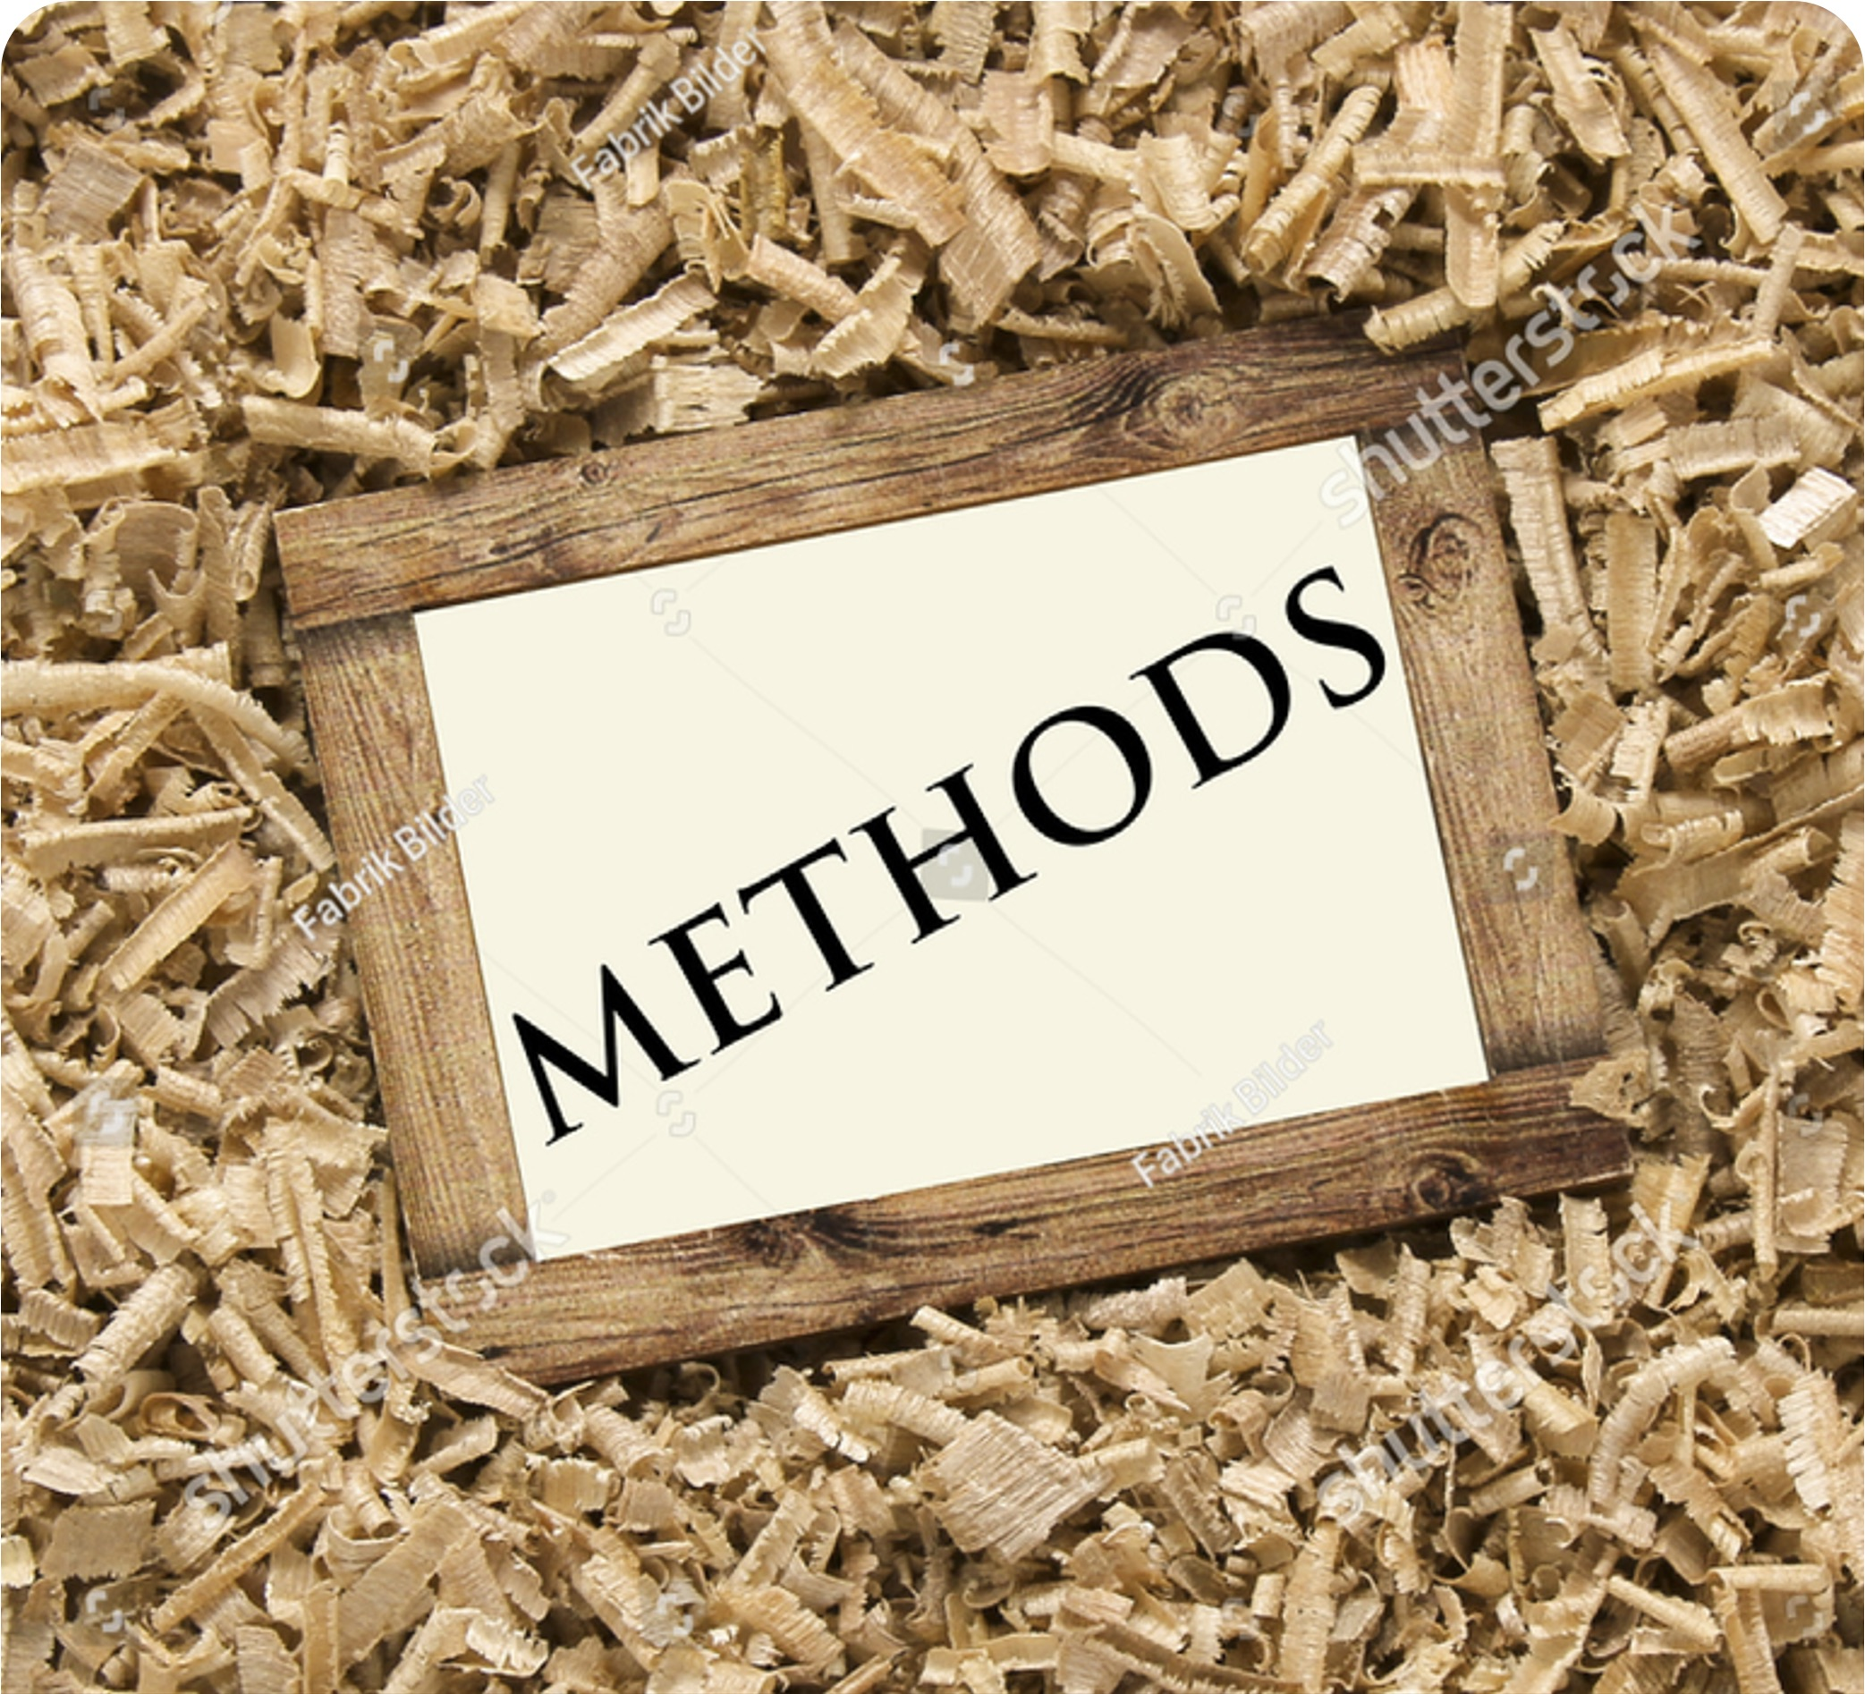
CANDIDATE SOURCING AND OUTREACH METHODS
  Post job openings on LinkedIn and Indeed.
  Leverage employee referral programs for sourcing.
  Attend career fairs to engage candidates.
  Use university alumni networks for outreach.
  Engage with professional associations for project management.
  Advertise on niche job boards like higher education.
Notes:
Sourcing of candidates effectively has much to do with creating a diverse pool of qualified applicants. Job openings can be advertised on popular boards such as LinkedIn, Indeed, and CareerBuilder so that many people get opportunities to apply. Employee referrals are also a good strategy for finding candidates, especially since employees often refer candidates that fit culturally and technically (Frampton et al., 2020). Again, attending career fairs has also been an important way of interacting with our prospective candidates, especially university alumni associations. Besides job boards on the internet, the alum network will be as useful in sourcing applicants who already have a familiarity with and sense of the environment that the institution holds precious. Engaging in associations dealing with professions such as project management and university management could be highly viable sources of superior caliber persons who qualify better for the role. This is achieved using different sourcing strategies to increase our chances of finding the best candidate for the Project Associate role.

Slide 10

SCREENING AND ASSESSMENT TECHNIQUES
  Review resumes to confirm required qualifications.
  Conduct phone screenings to gauge interest.
  Use interview scoring grid for consistency.
  Assess soft skills like teamwork and communication.
  Evaluate leadership qualities during interviews.
  Compare candidates based on total grid score.
Notes:
First of all, screening will include a thorough resume review to ensure the candidates at least match the minimum qualifications of the open position, including relevant degrees and years of experience. Then, phone screenings will be conducted to check the interest in the position and to clarify discrepancies in the resume. Once candidates have been shortlisted, structured interviews will be conducted to ensure that each candidate is rated consistently and equitably. During the interviews, the candidate's soft skills, communication, and leadership will be evaluated in addition to the pure technical competencies, such as project management. The candidate will be rated against the selection criteria stated in the job description on the recruitment grid, where scores for each candidate will be recorded. The goal is for the best candidates to move to the next step in selection.

Slide 11
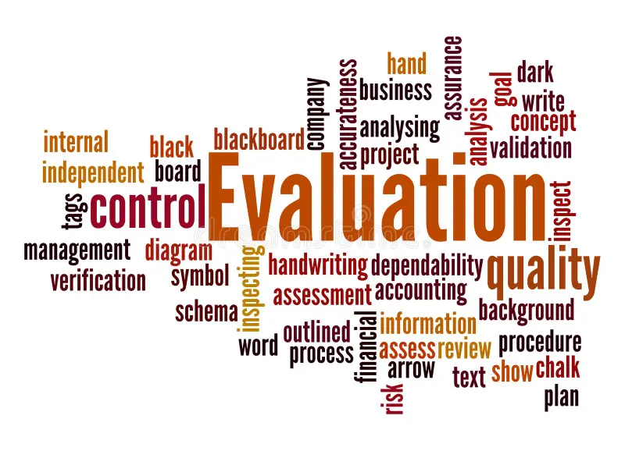
FINAL CANDIDATE EVALUATION AND SELECTION
  Review total score from essential and desirable requirements.
  Consider the interview score in final decision.
  Evaluate cultural fit for university environment.
  Involve HR and hiring managers in selection.
  Select candidate with highest total score.
  Notify other candidates and provide feedback.
Notes:
Evaluation When all candidates have been interviewed and screened, the final exercise will be the evaluation by scoring each candidate against the information in the recruitment grid; the total score from this grid will comprise the total on essential, desirable interview scoring that will be used as a basis of comparison amongst candidates. The highest-rated candidate will be considered for the best fit (Al-Shatti & Ohana, 2021). This process hence becomes essential in the qualification of such candidates but also endures regarding the values and work philosophy existing in the university for which they have applied. The involvement of HR and selection from the hiring managers reflects joint responsibility in making a relevant selection decision. The final candidate will be extended a formal job offer; the other candidates will be notified of the decision and feedback as part of a respectful and transparent process.

Slide 12

FINAL SELECTION AND CANDIDATE OFFER
  Review compensation and benefits package with selected candidate.
  Send formal job offer and include terms.
  Confirm start date and schedule onboarding.
  Complete necessary hiring paperwork.
  Inform other candidates of decision.
  Prepare for new hire’s orientation.
Notes:
After selecting the candidate, a discussion of compensation and benefits with the candidate will be the next phase. It is important to determine whether both parties agree on the issues concerning salary, benefits, and other contract information related to the employment. A formal job offer will be extended to the candidate, stating all terms and conditions of employment. Upon the confirmation of acceptance by the candidate, the Recruiter informs HR, who completes the onboarding process by providing an official start date and any relevant hiring paperwork (Frampton et al., 2020). The new hire may need preparation for orientation and introductions to working equipment, resources, and literature necessary for easy operation. Meanwhile, the backup candidates should be informed of this decision in case the selected candidate withdraws or cannot start. The recruiter will contact the successful candidate to confirm a start date and answer any questions they may have before starting their new role. Ensuring these are accomplished promptly will help ease the transition of the new Project Associate into the university setting.

Slide 13

CONCLUSION
  Recruitment process aligns with organizational goals.
  Essential and desirable requirements ensure thorough evaluation.
  Use of recruitment grid ensures objectivity in scoring.
  Interview process assesses technical and soft skills.
  Final selection based on total candidate score.
  Continuous feedback throughout ensures transparency and fairness.
Notes:
In conclusion, the selection process for the position of Project Associate is devised in a comprehensive, non-discriminatory way to meet university objectives. Application of the Recruitment Grid will ensure that all applicants are assessed against objective criteria comprising the essential requirements and desirable qualifications identified. Thus, the scoring system allocates a ranking based on criteria, while the interview examines technical and soft skills. This also includes cultural fit to ensure the selected candidate will prosper in the university environment. Continuous communication with HR and the hiring managers throughout the recruitment process ensures all parties are aligned to make the best decision. The structured approach of a transparent and efficient recruitment and selection process leads to selecting a qualified project associate.

Slide 14
REFERENCES
  Al-Shatti, E., & Ohana, M. (2021). Impression Management and Career Related Outcomes: A Systematic Literature Review. Frontiers in Psychology, 12(12). https://doi.org/10.3389/fpsyg.2021.701694
  Frampton, G. K., Shepherd, J., Pickett, K., Griffiths, G., & Wyatt, J. C. (2020). Digital tools for the recruitment and retention of participants in randomised controlled trials: a systematic map. Trials, 21(1). https://doi.org/10.1186/s13063-020-04358-3
  Maurer, R. (2023). Assessing Your Recruiting Function for Compliance and Best Practices. Shrm.org. https://www.shrm.org/mena/topics-tools/news/talent-acquisition/assessing-recruiting-function-compliance-best-practices

